Slide 1
Signed and Unsigned Number
Computer Architecture
Lecture 6

Slide 2
Introduction
Numbers are kept in computer hardware as a series of high and low electronic signals, and so they are considered base 2 numbers.
Just as base 10 numbers are called decimal numbers, base 2 numbers are called binary numbers.
A single digit of a binary number is thus the “atom” of computing, since all information is composed of binary digits or bits.
This fundamental building block can be one of two values, which can be thought of as several alternatives: high or low, on or off, true or false, or 1 or 0.

Slide 3

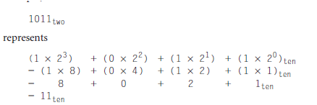
Cont.
Generalizing the point, in any number base, the value of ith digit d is
where i starts at 0 and increases from right to left. We subscript decimal numbers with ten and binary numbers with two

Slide 4

Cont.
We number the bits 0, 1, 2, 3, . . . from right to left in a word. The drawing below shows the numbering of bits within a MIPS word and the placement of the number 1011_{two}
Since words are drawn vertically as well as horizontally, leftmost and rightmost may be unclear.
Hence, the phrase least significant bit is used to refer to the rightmost bit (bit 0 above) and most significant bit to the leftmost bit (bit 31).

Slide 5
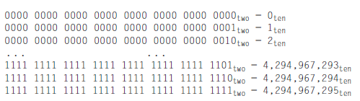
Cont.
The MIPS word is 32 bits long, so we can represent 2³² different 32‑bit patterns.
It is natural to let these combinations represent the numbers from 0 to 2³² – 1 (4,294,967,295_{ten}):

Slide 6
Cont.
That is, 32-bit binary numbers can be represented in terms of the bit value times a power of 2 (here xi means the ith bit of x):
Hardware can be designed to add, subtract, multiply, and divide these binary bit patterns.
If the number that is the proper result of such operations cannot be represented by these rightmost hardware bits, overflow is said to have occurred.

Slide 7
Cont.
Computer programs calculate both positive and negative numbers, so we need a representation that distinguishes the positive from the negative.
The convention for representing signed binary numbers is called two’s complement representation:

Slide 8
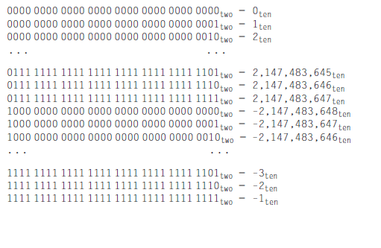
Cont.
Two’s complement does have one negative number, -2,147,483,648_{ten}, that has no corresponding positive number.

Slide 9
Question
Explain with example why sign and magnitude form is rarely used for computer arithmetic?

Slide 10
Signed Number
Two’s complement representation has the advantage that all negative numbers have a 1 in the most significant bit.
Consequently, hardware needs to test only this bit to see if a number is positive or negative (with the number 0 considered positive).
This bit is often called the sign bit. By recognizing the role of the sign bit, we can represent positive and negative 32-bit numbers in terms of the bit value times a power of 2:
The sign bit is multiplied by -2³¹, and the rest of the bits are then multiplied by positive versions of their respective base values.

Slide 11

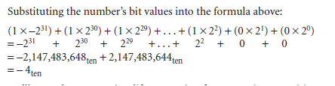
Example.
Solution

Slide 12

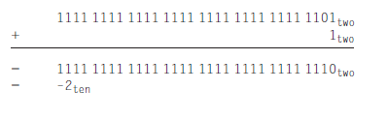
Negation Shortcut
Negate 2_{ten}, and then check the result by negating -2_{ten}.
Negating this number by inverting the bits and adding one,

Slide 13

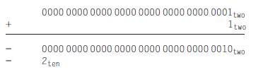
Negation Shortcut-Cont.
Going the other direction,
is first inverted and then incremented:

Slide 14
Sign Extension Shortcut
how to convert a binary number represented in n bits to a number represented with more than n bits.
The shortcut is to take the most significant bit from the smaller quantity—the sign bit—and replicate it to fill the new bits of the larger quantity.
The old bits are simply copied into the right portion of the new word. This shortcut is commonly called sign extension.

Slide 15


Example
Convert 16‑bit binary versions of 2_{ten} and -2_{ten} to 32‑bit binary numbers.
Solution
The 16‑bit binary version of the number 2 is
It is converted to a 32‑bit number by making 16 copies of the value in the most significant bit (0) and placing that in the left-hand half of the word. The right half gets the old value:

Slide 16
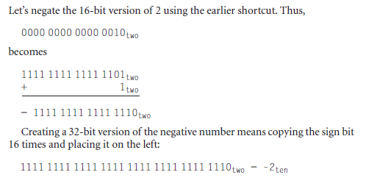
Cont.

